Slide 1
Bielefeld Reshaping the inner city
Olaf Lewald
City of Bielefeld
Head of Office for Mobility

Slide 2
Bielefeld
Bielefeld is a medium-sized city of 340,000 inhabitants in North Rhine-Westphalia, Germany.
2019 SUMP: Reduction of car traffic from 51% share to 25% until 2030
Aim:
A a safe and resilient sustainable mobility system
New use of public space.

Slide 3
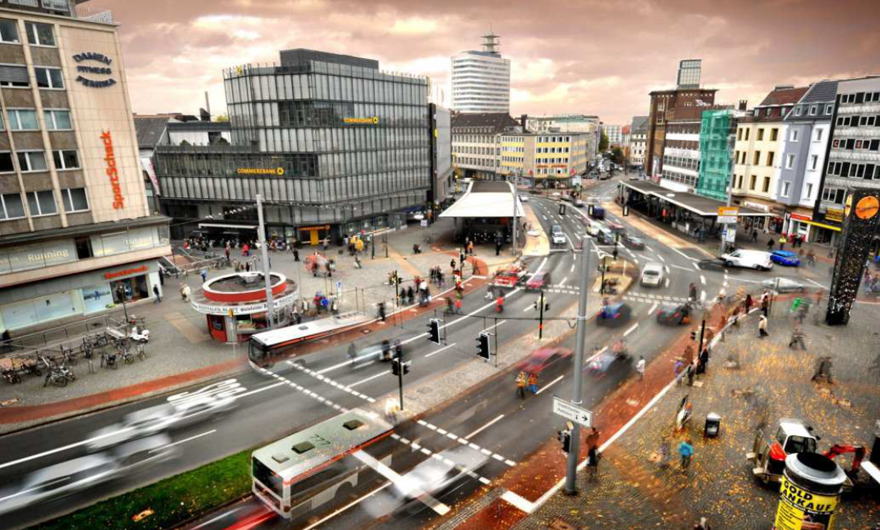
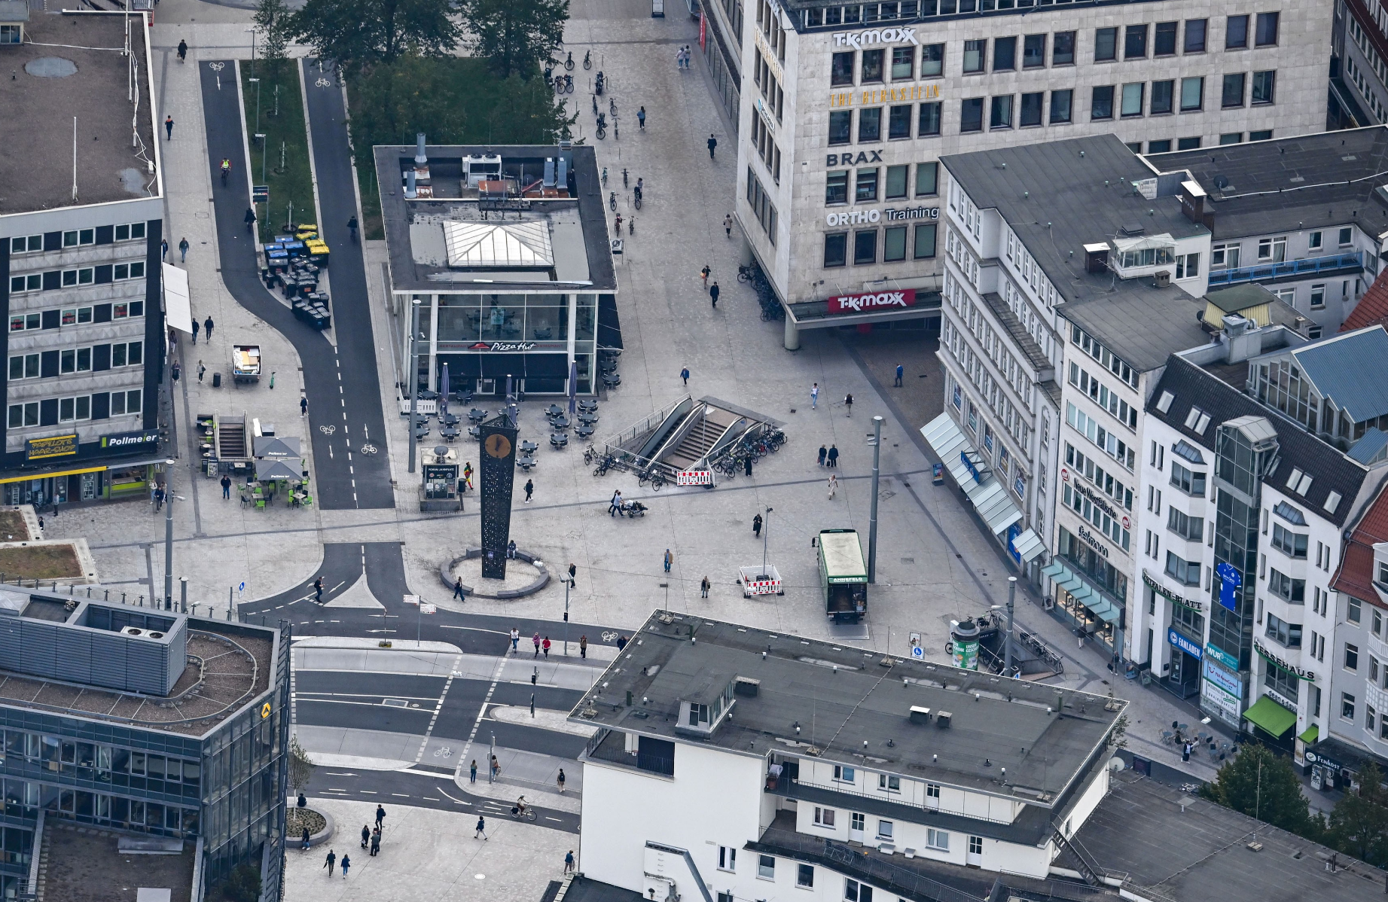
Transformation of Jahnplatz
Before the ReVeAL pilot in the city’s historical town, Bielefeld had already begun a project to reduce car use in its urban areas: the transformation of Jahnplatz.
The square is located at the northern edge of the historic city centre.
It was being transitioned into a space for active mobility and slower – and less–motorised traffic through the reallocation of car lanes to bus and cycle lanes, the reduction of the speed limit from 50km/h to 30km/h, and the creation of new attractive public spaces.

Slide 4
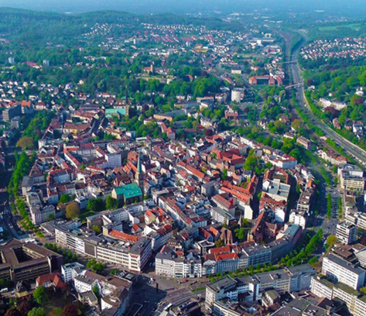
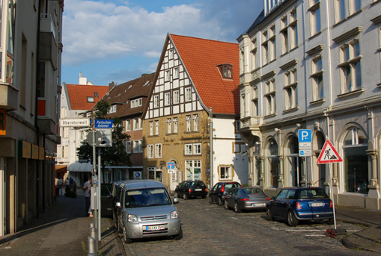
Pilot project in Bielefeld’s horseshoe-shaped old town
Challenge:
Narrow streets with little space for pedestrians and cyclists
Much on-street parking
Through traffic
Air quality and road safety
Delivery and access to shops, restaurants etc.

Slide 5
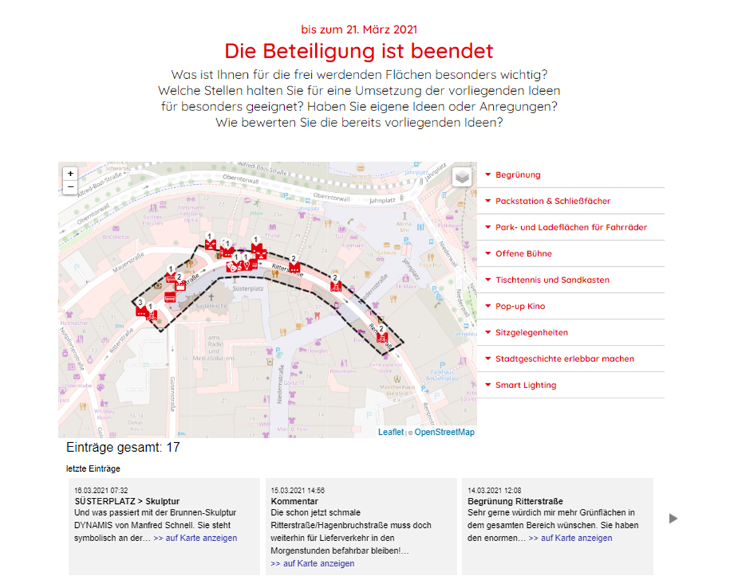
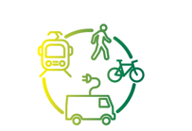
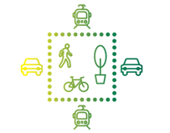
Comprehensive stakeholder consultation
Through data collection, coordinated planning and extensive stakeholder engagement, a thorough pilot project was implemented in Bielefeld’s horseshoe-shaped old town.
This area is strategically located: it is adjacent to Jahnplatz, the main mobility hub in the city centre which was in the process of being rebuilt when ReVeAL started
11/2/2022
5

Slide 6
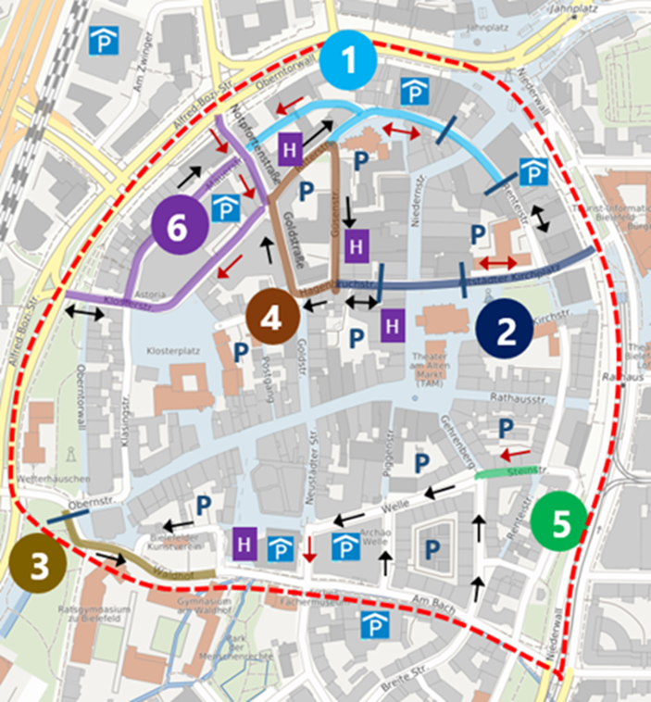
Testing Phase
Various measures for traffic management and the new use of traffic space were tried out during a test phase from June 2021 to the end of February 2022
Relevant actors from the public sector, business and civil society were involved in the development of the test phase.
11/2/2022
6

Slide 7
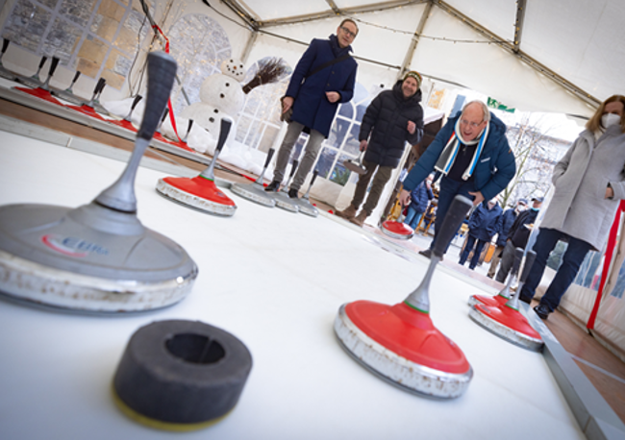
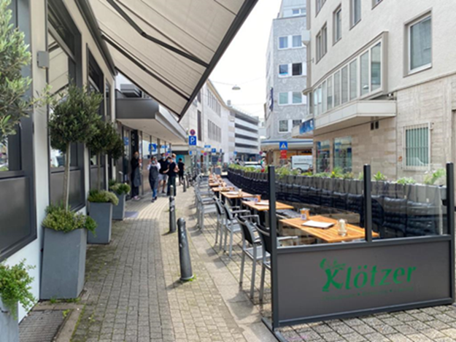
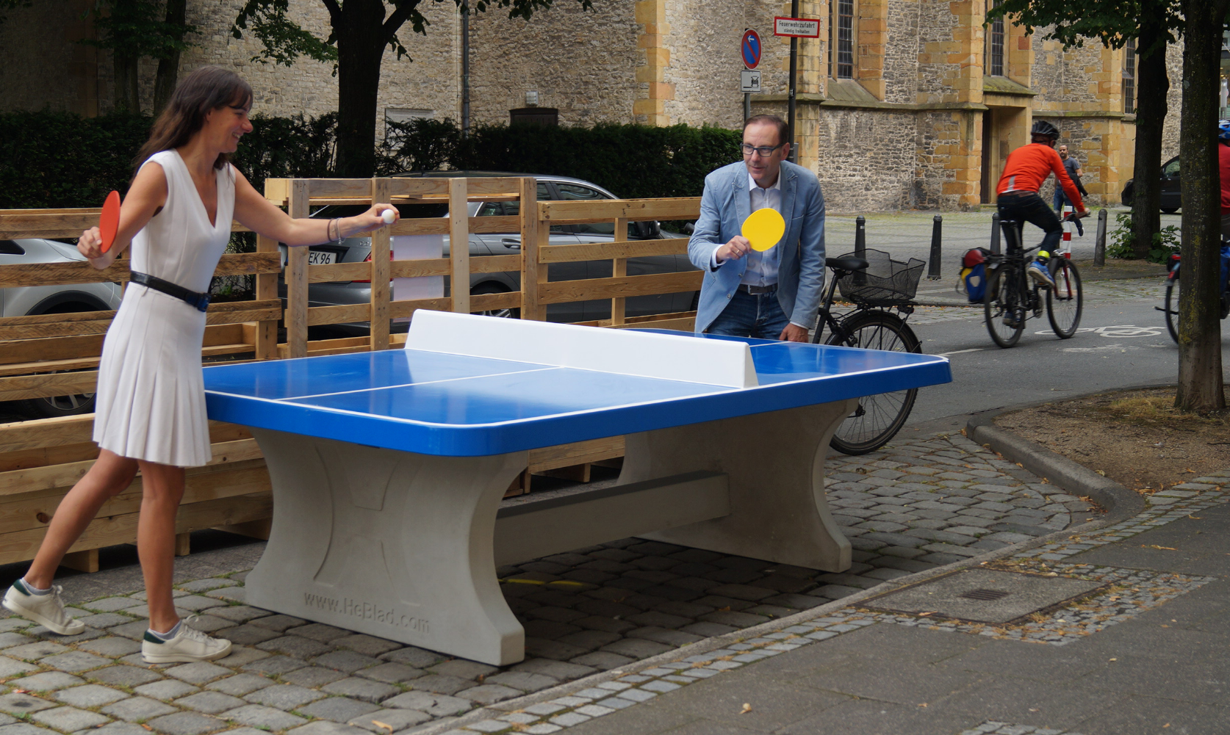
Testing Phase
11/2/2022
7

Slide 8
Thank you for your attention
Olaf Lewald

