Slide 1
ReVeAL Final Consortium Meeting
Jerusalem - A Tale of a City
London, November 2022
Nimrod Levy
Environmental engineering department manager
The Environmental Quality Department, Municipality of Jerusalem

Slide 2
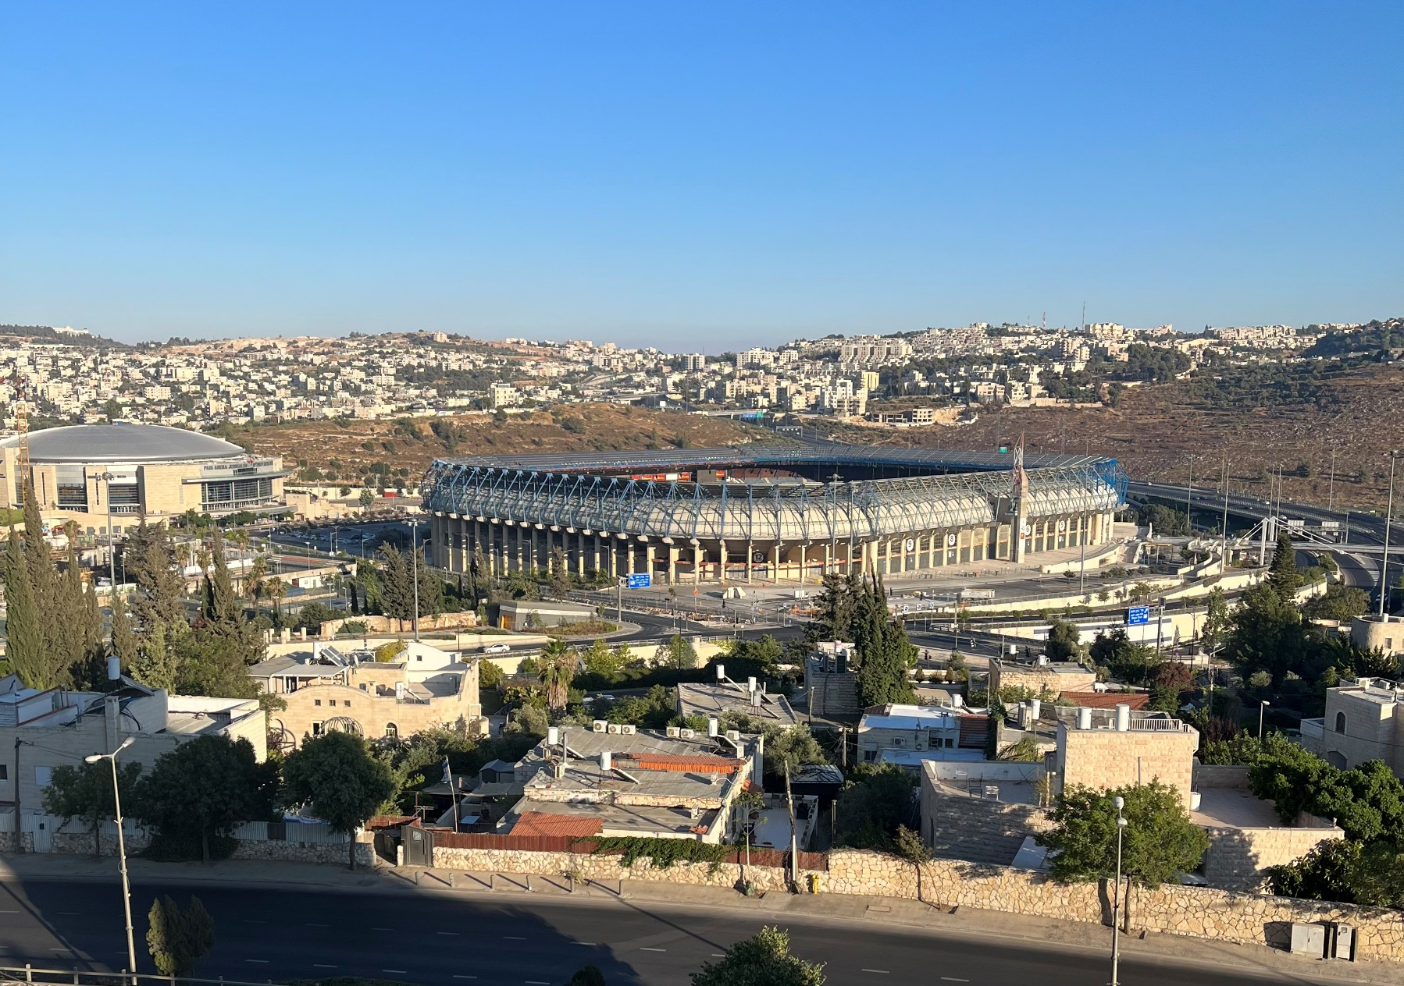
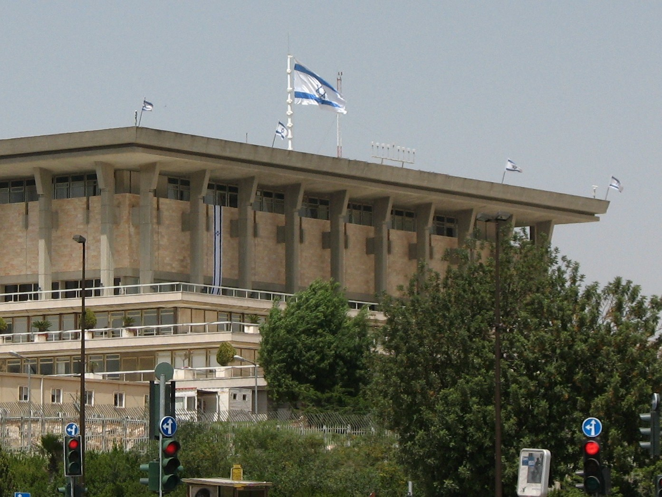
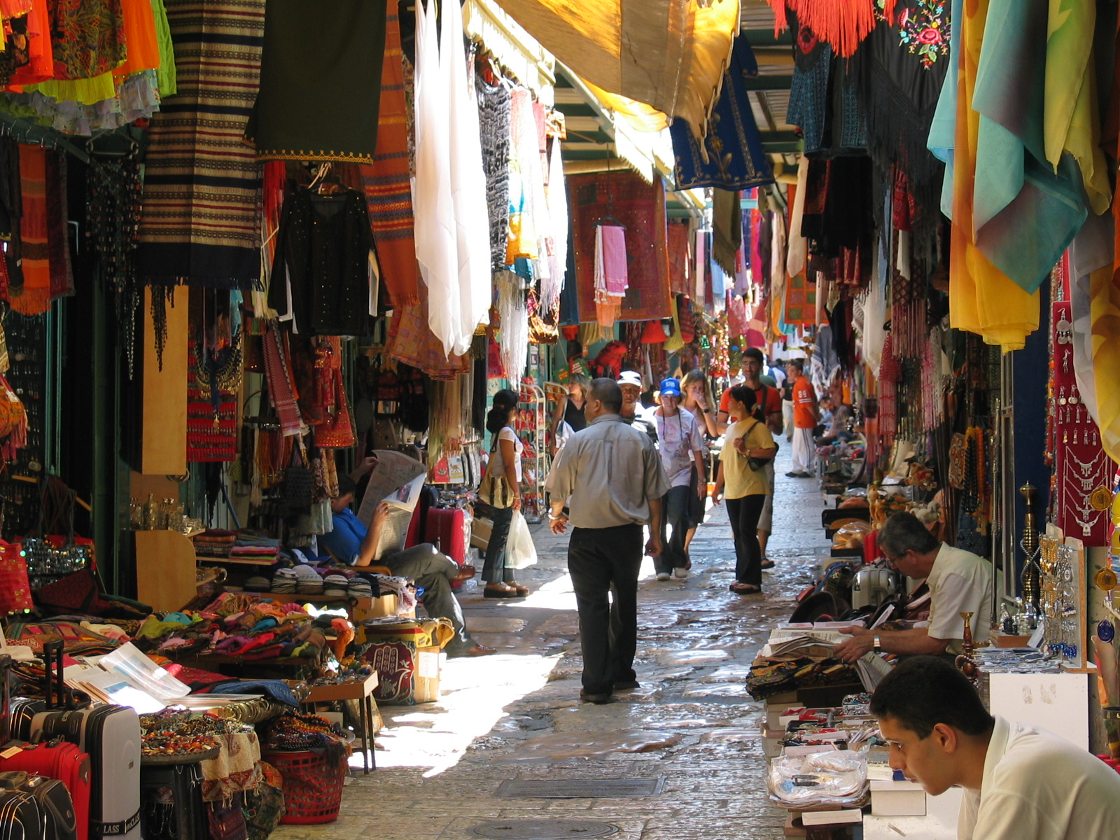
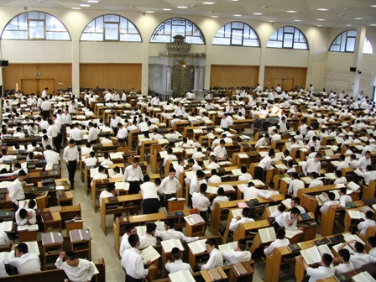
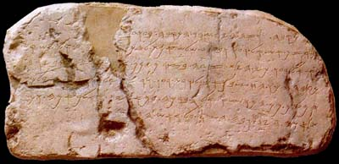
Background
Capital of Israel
5000 Years old
126 sq km
Population - 1 million
Multi culture
Multi language

Slide 3
Team

Slide 4
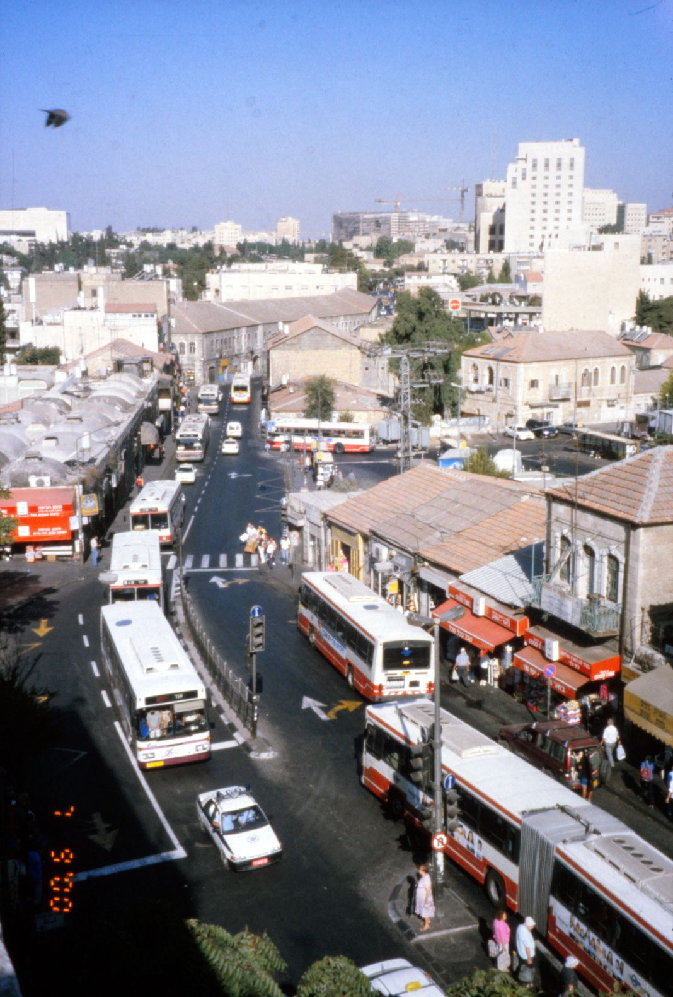
Base Line
Air quality – Not meeting international standards
Awareness – lacking

Slide 5
Work Process
Identification sources of pollution
Project Execution
Knowledge Base
Municipality
Ministry of Environmental Protection
International - ReVeAL
Definition of possible projects - Plan
Definition of Implementation Steps
Choosing a Project to Implement

Slide 6
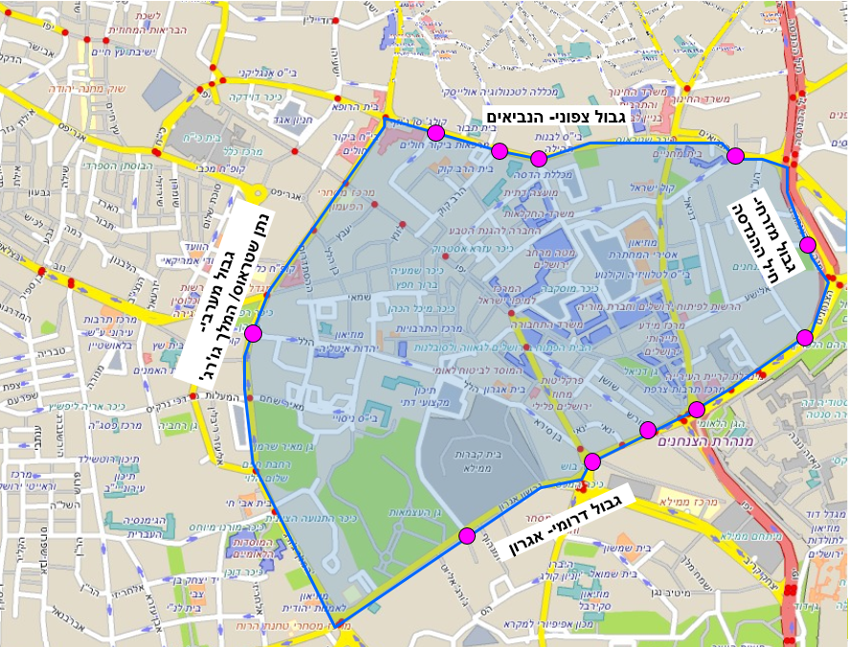
1st Program to Reduce Air-Pollution – 2016-2019
Low Emission Zone
Pilot area – 0.75 sq km
Define polluting vehicles
Restrict polluting vehicles

Slide 7
2^{ed} Program to Reduce Air-Pollution - 2019

Slide 8
Work Process
Identification sources of pollution
Project Execution
Knowledge Base
Municipality
Ministry of Environmental Protection
International - ReVeAL
Definition of possible projects - Plan
Definition of Implementation Steps
Choosing a Project to Implement

Slide 9
The Scope

Slide 10
Work Process
Identification sources of pollution
Project Execution
Management Team
Municipality
Ministry of Environmental Protection
project manager
consultants
Definition of possible projects - Plan
Definition of Implementation Steps
Choosing a Project to Implement

Slide 12
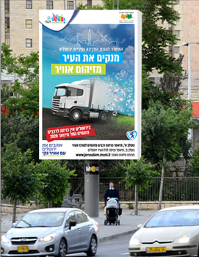
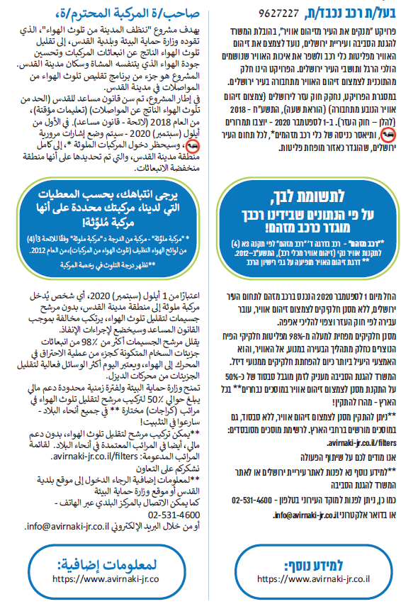
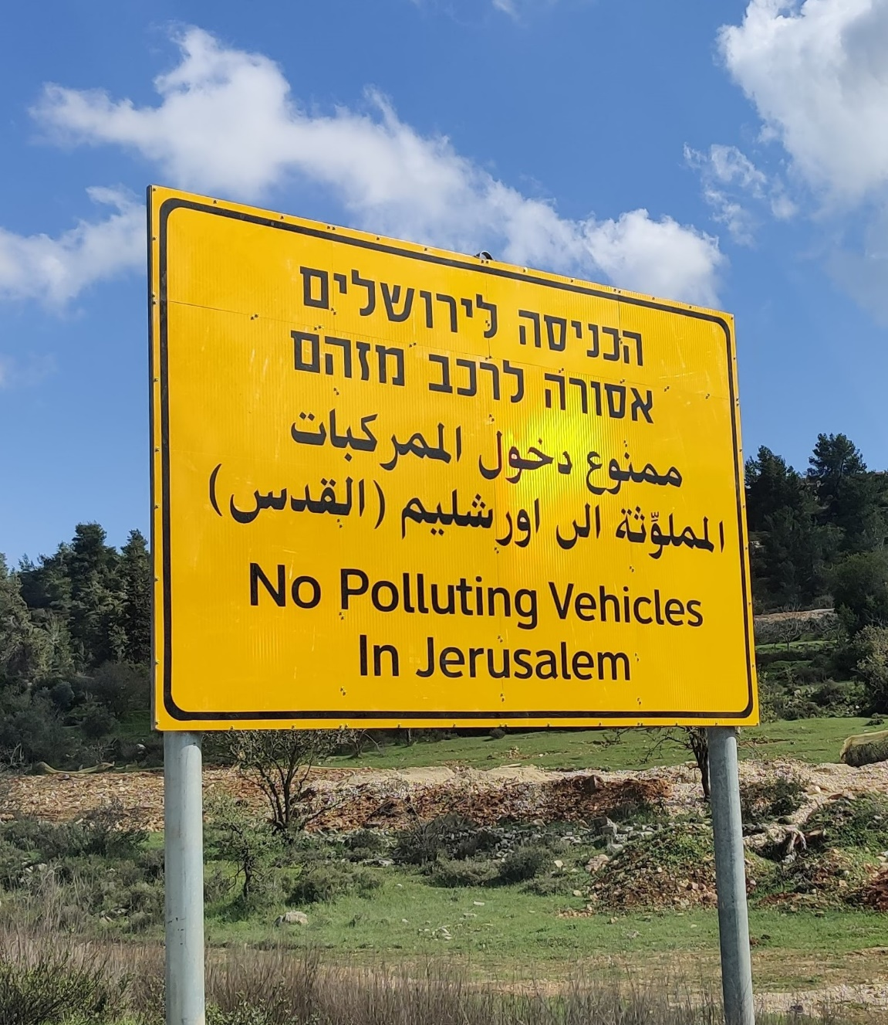
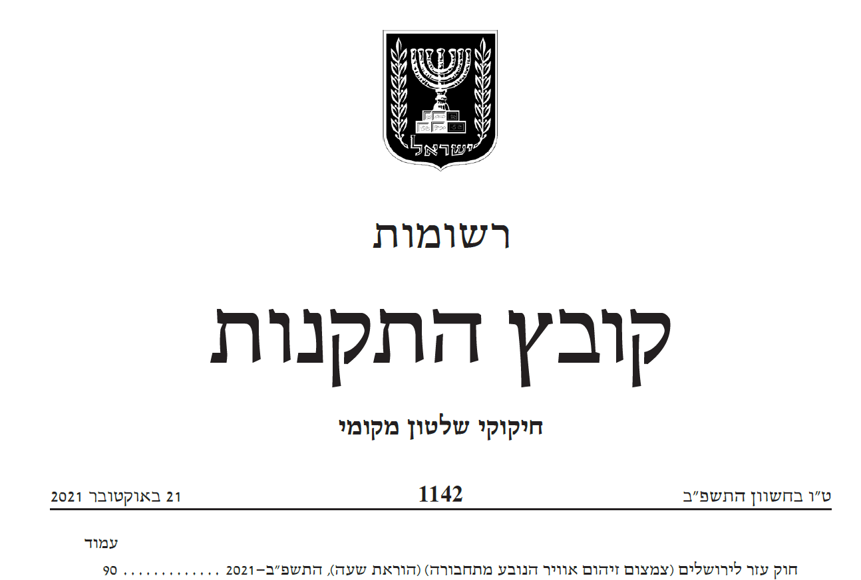
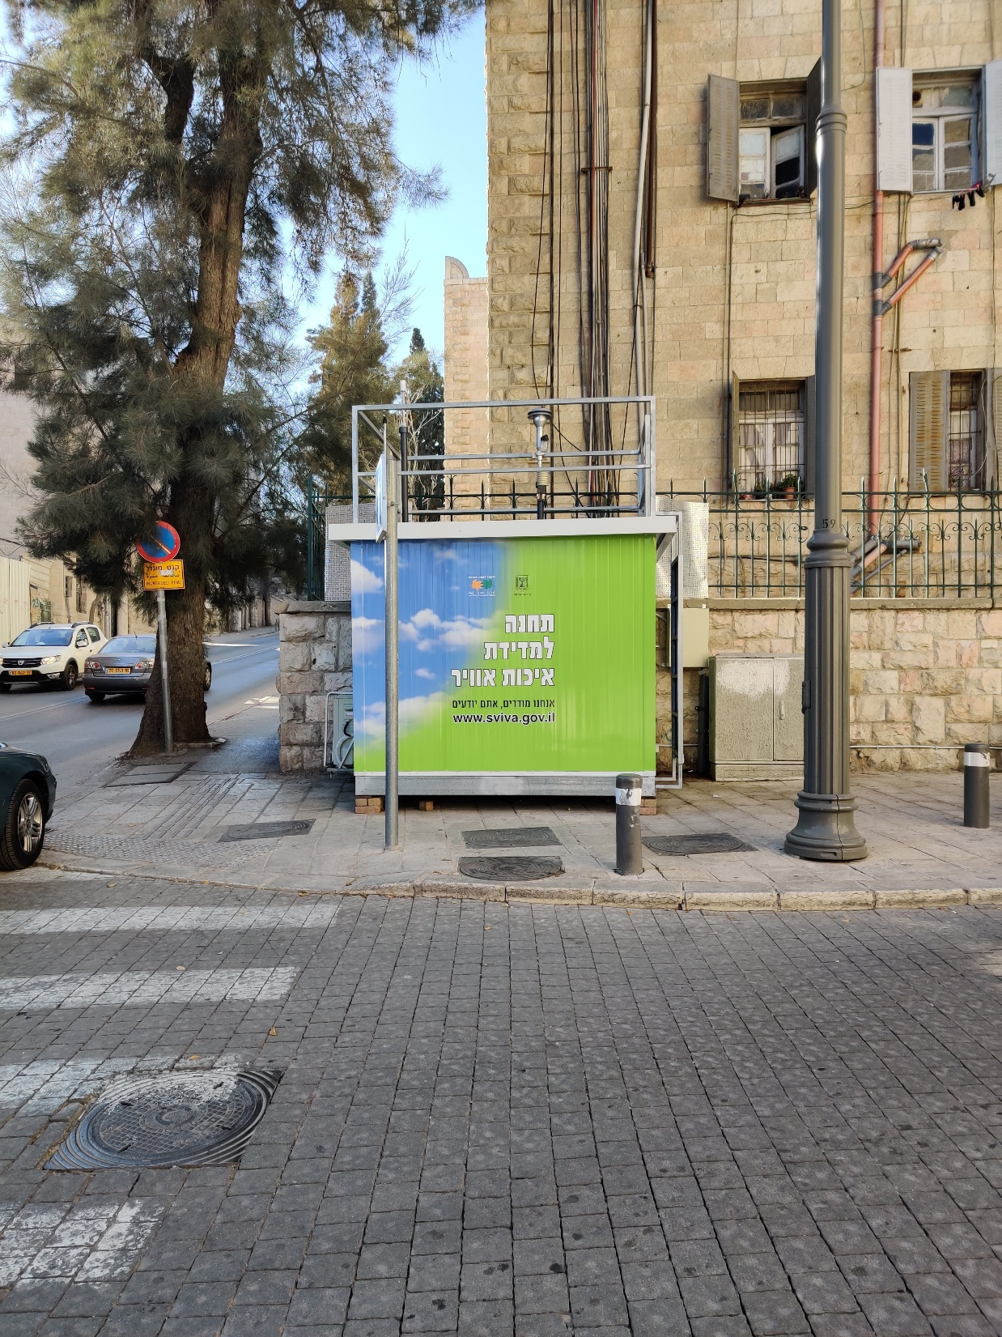
Project Execution
Legislation
Road Sign and location
Advertising
Public Notice
Monitoring
Enforcement

Slide 13
Work Process
Identification sources of pollution
Project Execution
Knowledge Base
Municipality
Ministry of Environmental Protection
International - ReVeAL
Definition of possible projects - Plan
Definition of Implementation Steps
Choosing a Project to Implement

Slide 14
Reducing Air-Pollution from N.R.M.M. (Non-Road Mobile Machinery)
Looking Forward –
18 / 5,000
Translation results
Analysis
Negotiation
Regulation

Slide 15
Lessons Learned and ReVeAL contribution
18 / 5,000
Translation results
Knowledge
Legitimization
Pareto principle –
Max impact – Min Disruption
Precedent setting for Israel

Slide 16
Thank you
Nimrod Levy
Environmental engineering department manager
The Environmental Quality Department, Municipality of Jerusalem
Lvnimrod@jerusalem.muni.il

