Slide 2
Complementary Measures
Cosimo Chiffi (TRT)

Slide 3
These are additional measures that complements a planned UVAR to ensure access of people, goods or services into the UVAR area while maintaining the goals of the UVAR, easing compliance and facilitating the best adaptation to the new reality. It also serve to minimise any equity issues and undesirable impacts that may result from the UVAR

Slide 4
Additional measures aimed at >> easing compliance and facilitating the best adaptation to a newly introduced UVAR >> minimising any equity issues and undesirable impacts that may result from the UVAR

Slide 5
Complementary Measures
Complementary sustainable mobility measures
Financial or in-kind incentives
Exemptions
Organisational support or other solutions based on the local situation

Slide 6
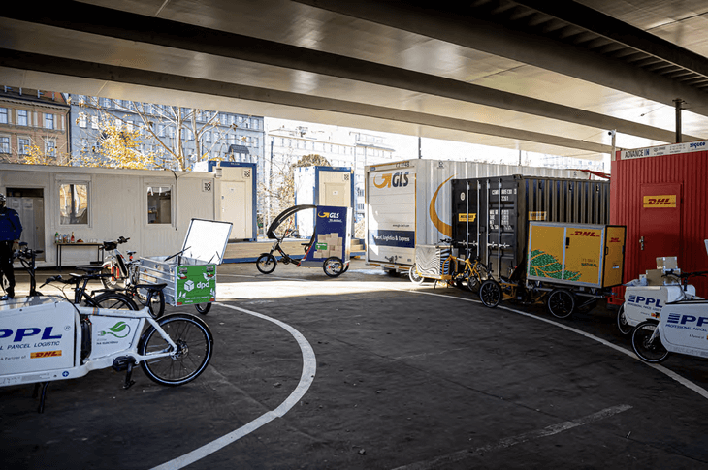
1. Complementary sustainable mobility measures
>>> refer to the mobility schemes and related services that may be needed to help an UVAR to reach its full potential
Improvements in public transport
Enhancement of cycling and walking
Changes in parking system
Enhancement of shared mobility
Improvements in urban logistics
Zero and low emission vehicles
Ticketing and digital support
…
KOMODO cycelogistics shared hub in Berlin

Slide 7
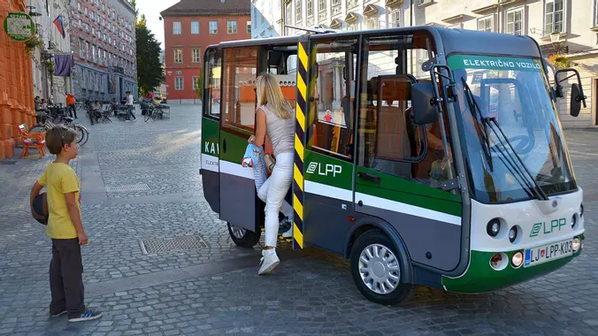
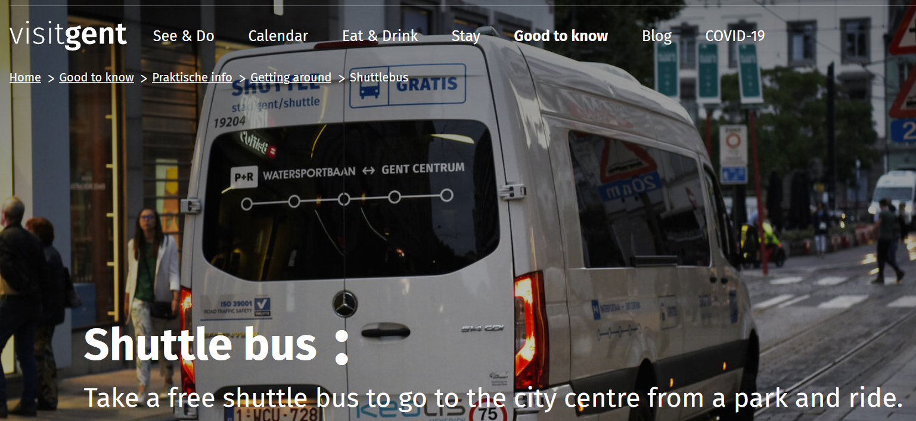
1. Complementary sustainable mobility measures
«Kavalir» free microbus in the LTZ of Ljubljana (SI)
+ off street parking facilities for residents
+ time-limited and differentiated parking tariffs
P+R free shuttle bus to the car-free area of Ghent (Belgium)
+ resident parking zone immediately outside the car-free area
+ cycle streets
+ 7,000 bicycles available for long rent

Slide 8
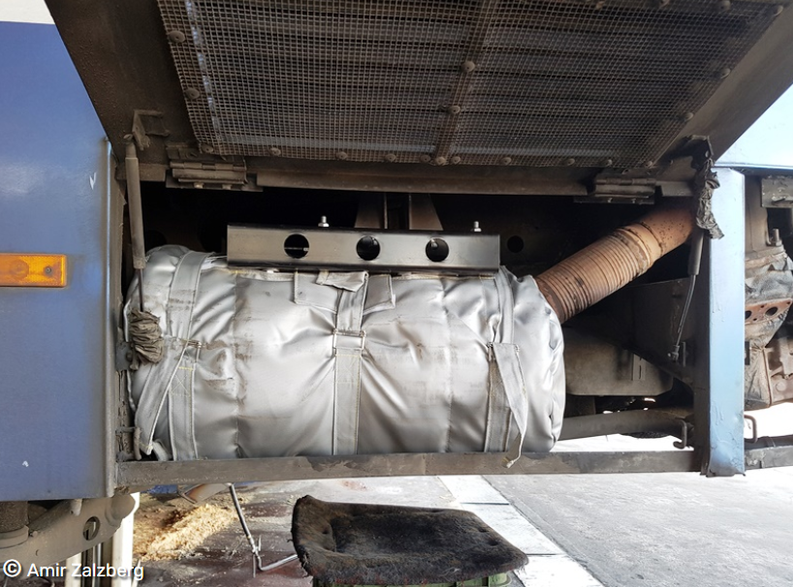
2. Financial or in-kind incentives
>>> are intended to make compliance easier, facilitate the most beneficial compliance method and address possible inequities
Financial subsidies for fleet renewal including tax exemptions or grants
Grants towards retrofits (e.g. diesel particulate filters or fuel conversion)
Compensation (either financial/voucher) for the scrappage of an old vehicle
(Discounted) Membership or vouchers for sustainable mobility options
Monetary incentives for cycling (e.g. bike to work or e-bike/cargo bike grants)
A subsidised diesel particulate filter installed on a truck in Jerusalem
Notes:
Financial subsidies for fleet renewal (e.g., purchase, rental or leasing of greener vehicles, including tax exemptions or grants),
Membership or vouchers for sustainable mobility options (e.g., discount cards, free rides or annual passes for public transport, shared mobility or consolidation centres)
Monetary incentives for cycling (e.g., incentives for cycling to work or for the purchase of an (e-)cycle or (e)-cargo bike),
Grants towards retrofits (e.g., diesel particulate filters , a new engine or fuel conversion) or
Compensation (either financial or through a voucher) for the scrappage of an old vehicle – often differentiated by emission standards, vehicle type or owner income.

Slide 9
2. Financial or in-kind incentives
BOLOGNA
Mobility Bonus
Grants for vehicles not meeting the ULEZ standard
£1,000 to scrap a motorcycle or moped
£2,000 to scrap a car
Only for residents eligible for other benefits (e.g. income support, housing benefit)
special discounts/deals like a year's free membership of Santander bike hire scheme
year's free PT membership for over 60, with benefits, disabled or travelling with children
€1,000/family vs. 2 permits EURO 0 vehicles
€700/family vs. the sole permit EURO 0
€500/family vs. 1 permit EURO 0
2 years validity – different mobility options
Over 70 residents can choose between the voucher and a year's free PT membership
+ €1,000/500 (cargo)bike subsidy up to 50%
Notes:
Financial subsidies for fleet renewal (e.g., purchase, rental or leasing of greener vehicles, including tax exemptions or grants),
Membership or vouchers for sustainable mobility options (e.g., discount cards, free rides or annual passes for public transport, shared mobility or consolidation centres)
Monetary incentives for cycling (e.g., incentives for cycling to work or for the purchase of an (e-)cycle or (e)-cargo bike),
Grants towards retrofits (e.g., diesel particulate filters , a new engine or fuel conversion) or
Compensation (either financial or through a voucher) for the scrappage of an old vehicle – often differentiated by emission standards, vehicle type or owner income.

Slide 10
3. Exemptions
>>> to make compliance easier and mitigate the impact on certain disadvantaged groups; should be as few as possible, clear and transparent, time-limited (‘sunset’) during the introductory phase
key exemptions (e.g., police, fire department, waste collection, etc.)
user needs exemptions (e.g., taxis, residents)
exemptions for adapted vehicles
a limited number of purchased exemptions (e.g., a given number of entries per day/month/year, a quota of allowed kilometres or "credits" allocated to individuals or businesses)
GPS-based low mileage exemption system in Lombardy (Italy)

Slide 11
4. Organisational support or other solutions based on the local situation
>>> logistical, administrative, promotional or other types of support the city can provide
Supporting alternative business models for facilities affected by the UVAR (e.g. car park inside the zone)
Projects to support the changeover to sustainable mobility (e.g. free trials of cargo bikes or shared electric vans)
Promotional activities
Guidance materials
Little adaptations of time windows
Guidance on urban freight and ZEZ in UK and The Netherlands

Slide 12
Thank you for your attention
Cosimo Chiffi (TRT)

