Slide 1
UVAR and the EU
Ivo Cré, POLIS
REVEAL FINAL CONFERENCE, 9-11, LDN

Slide 2
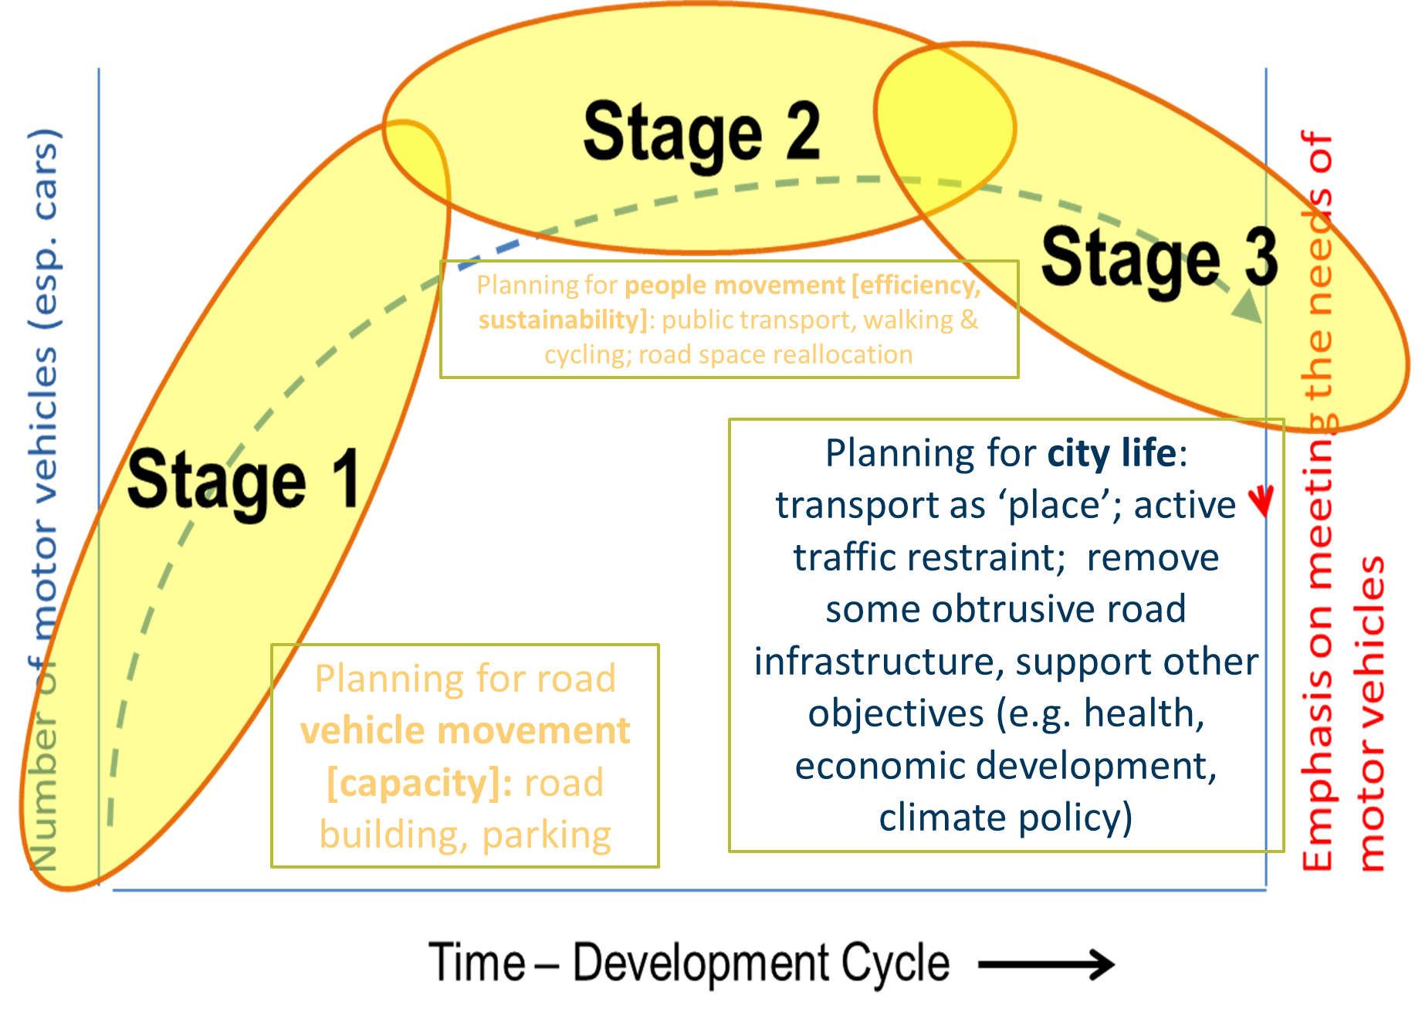
Source: CREATE project

Slide 3
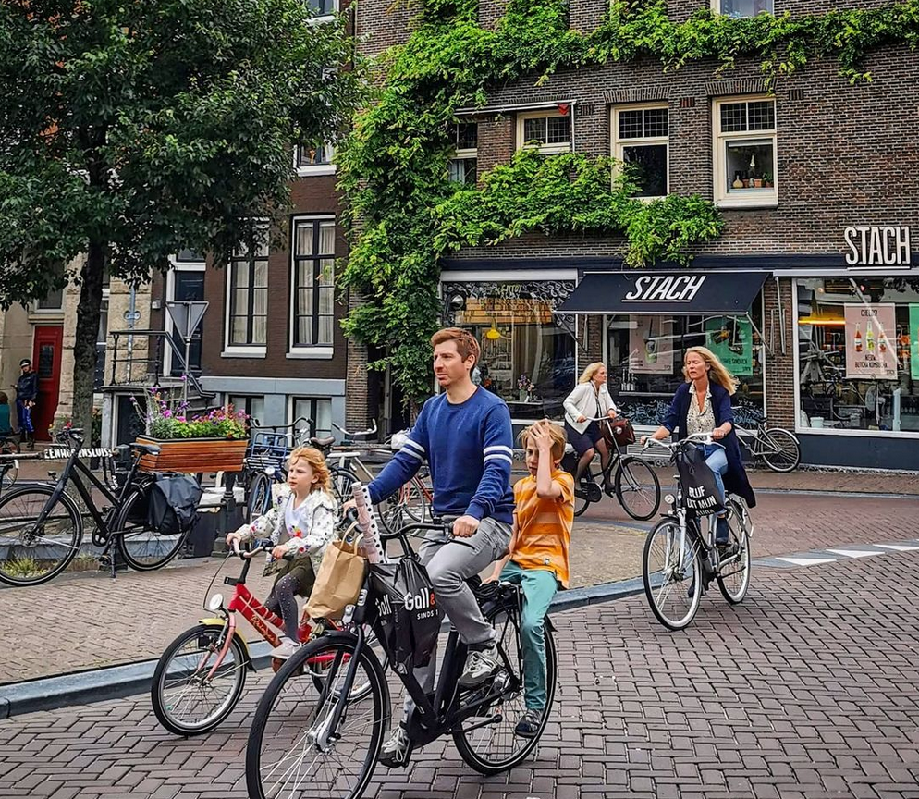
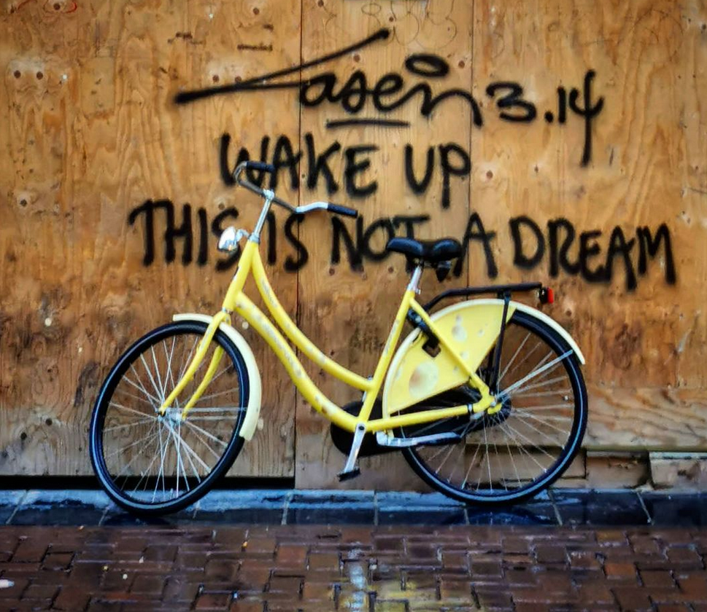
Enabling the 15-minute city

Slide 4
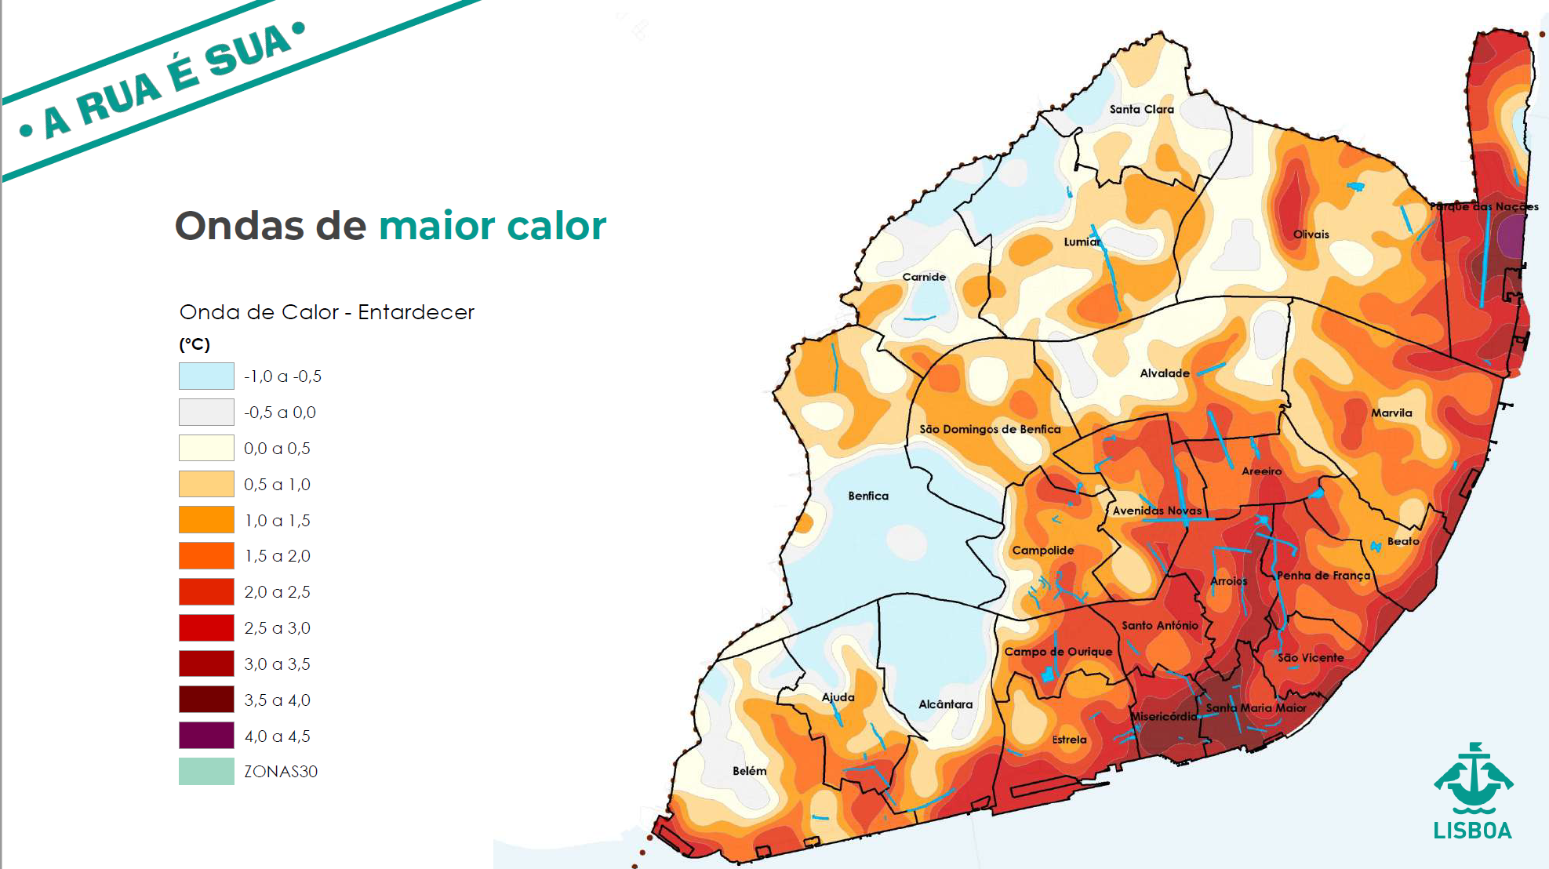
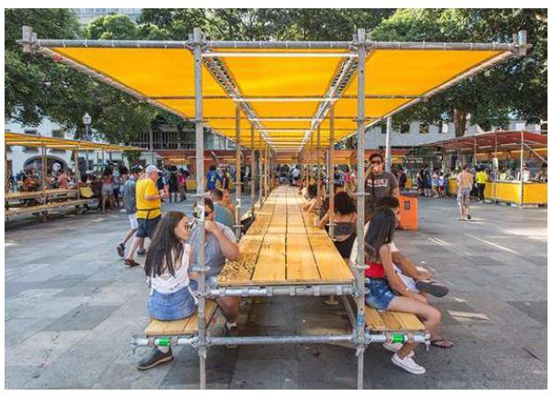
FLOW? Destination!
Notes:
Case study: A Rua e Sua, Lisbon
Lisbon’s A Rua e Sua (‘The Street is Yours’) plan aims to put people first and prioritise active travel throughout the city. The plan will see space reallocated to create wider pavements, additional space around public transport stops, space for seating outside bars, cafes and restaurants, and wider improvements to the urban realm such as 'shadow spaces' to provide shade in public spaces. A new 30km/h speed limit is also coming into force to give greater safety and priority for people in the city.

Slide 5
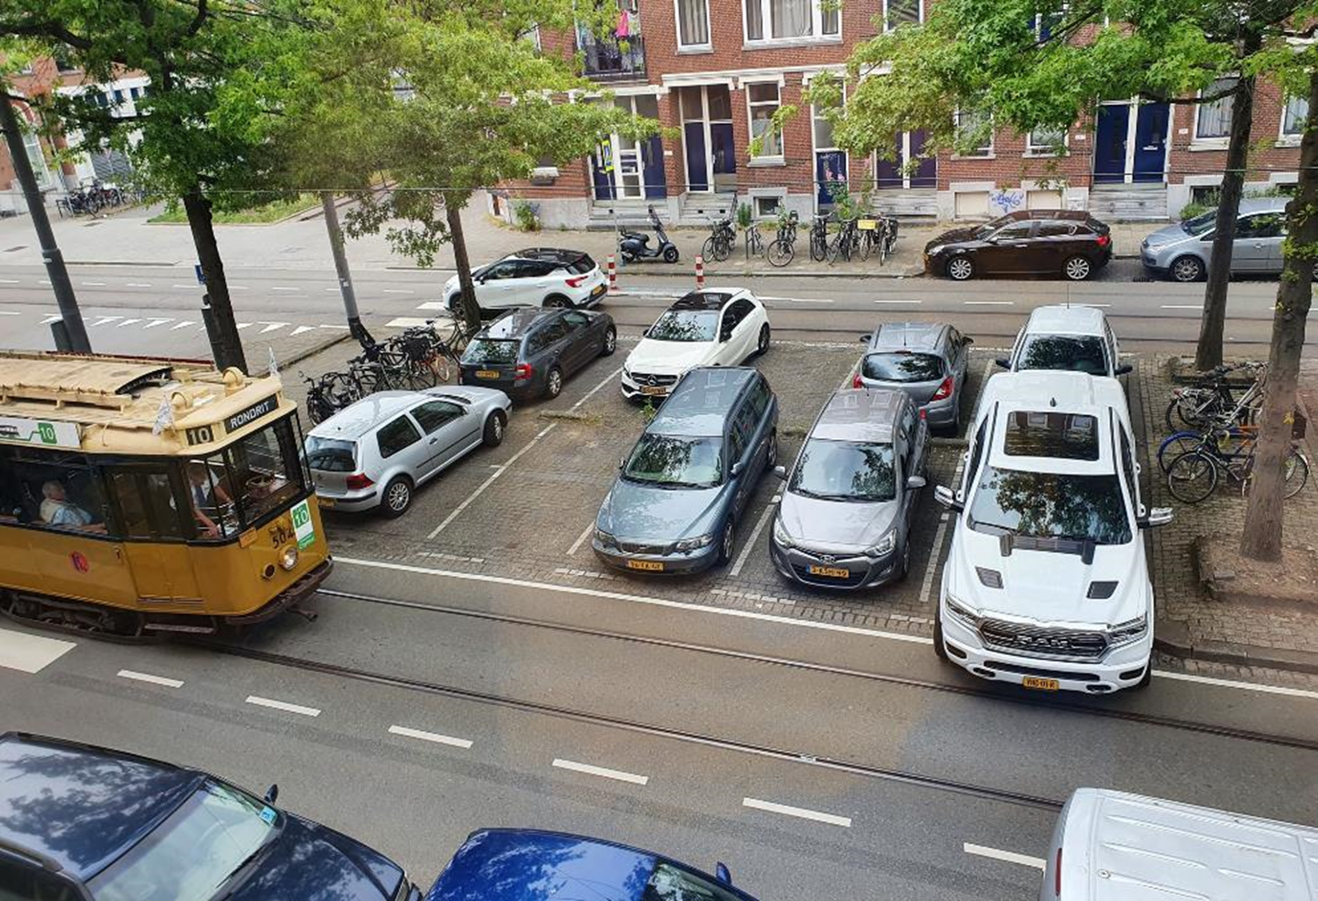

Slide 6


Slide 7


Slide 8
to enable UVARs?

Slide 9

Pointers for
Comprehensive
UK framework
to enable UVARs?

Slide 10
Spatial Interventions
Pricing measures
Regulatory measures
School street
Cycling street
Traffic filter
Removing parking/road
Cycle lane
Pedestrian street
Bus/tram priority lane
Woonerf
Congestion charge
Pollution charge
Parking charge
Traffic flow management
Urban logistics charge
Regulation by emissions
Regulation by vehicle type/dimension
Regulation by trip purpose
Scheme timescale
Regulation by permit
Regulation by other
Complementary measures
Financial incentives
Exemptions
Increased mobility options
Individual solutions
Ensuring Compliance
Notes:
Long list in 3 MF + FO and CM, methodology of combining BB for different strategies

Slide 11
Spatial Interventions

Slide 12
Spatial Interventions
Notes:
Long list in 3 MF + FO and CM, methodology of combining BB for different strategies

Slide 13
Spatial Interventions
Pricing measures

Slide 14
Spatial Interventions
Pricing measures
EUROVIGNETTE
EUROPEAN ELECTRONIC TOLING SYSTEM
INTERNALISATION of EXTERNAL COSTS of TRANSPORT

Slide 15


Slide 16
Spatial Interventions
Pricing measures
Notes:
Long list in 3 MF + FO and CM, methodology of combining BB for different strategies

Slide 17
Spatial Interventions
Pricing measures
Regulatory measures
Notes:
Long list in 3 MF + FO and CM, methodology of combining BB for different strategies

Slide 18

Spatial Interventions
Pricing measures
Regulatory measures
Strengthened AQ norms FITfor55: Phase out of sales of internal combustion engine vehicles by 2035
Alternative Fuels Infrastructure Regulation
Clean Vehicle Directive
But: EURO7 problem
Notes:
Long list in 3 MF + FO and CM, methodology of combining BB for different strategies

Slide 19
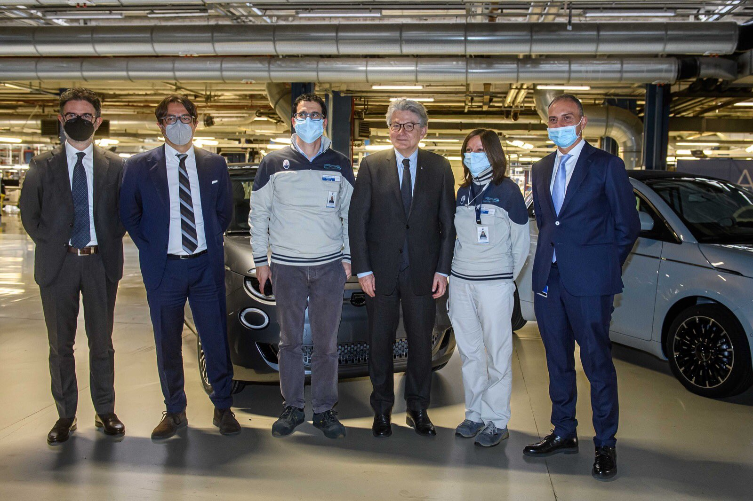

Slide 20
Spatial Interventions
Pricing measures
Regulatory measures

Slide 21
Spatial Interventions
Pricing measures
Regulatory measures
Complementary measures
MaaS: intermodal passenger rights
Geofencing (EURO7)
Notes:
Long list in 3 MF + FO and CM, methodology of combining BB for different strategies

Slide 22
SUMP as framework for UVAR
Spatial Interventions
Pricing measures
Regulatory measures
Complementary measures
Notes:
Long list in 3 MF + FO and CM, methodology of combining BB for different strategies

Slide 23

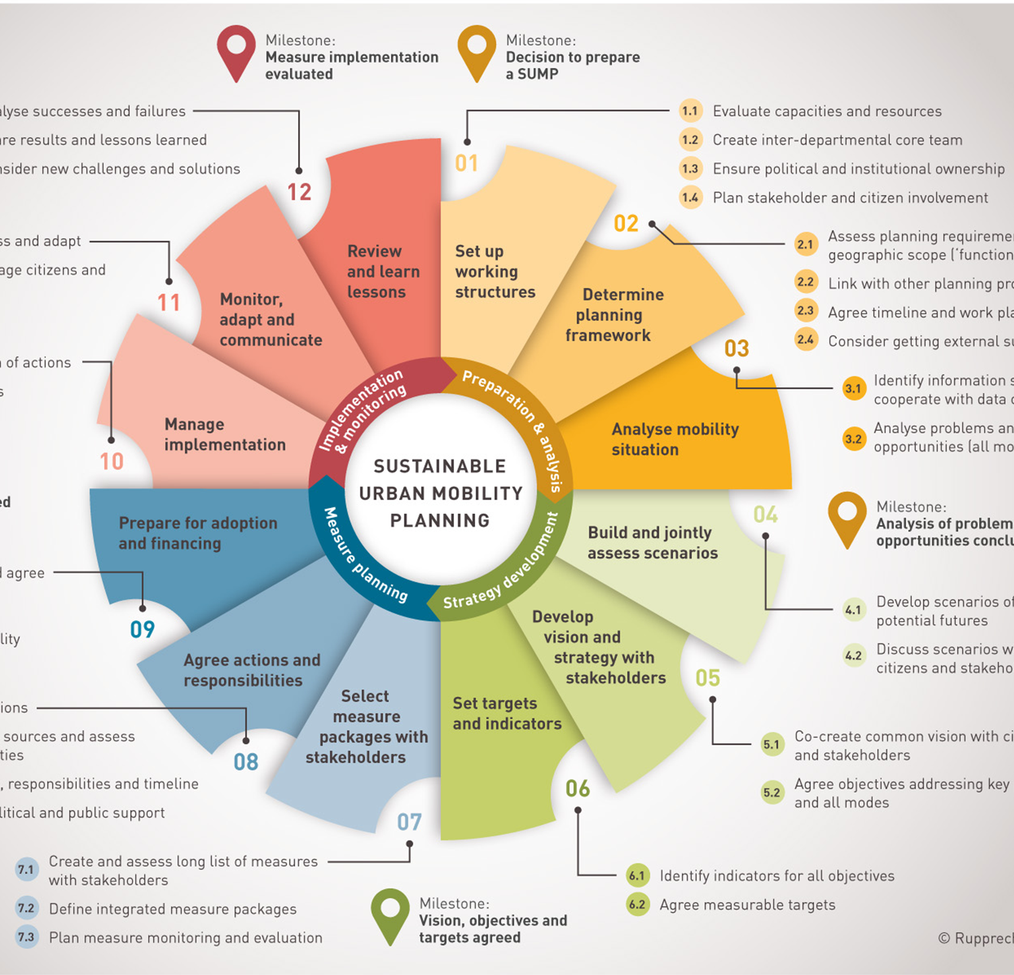
SUBSIDARITY IN MOTION:
from 88 to 424 URBAN NODES in the TEN-T
Cities above 100.000 inhabitants = an essential part of the TEN-T:
Urban Nodes linking local, regional, national and international transport flows for goods and passengers
Requirements: SUMP, SUMI, intermodal interchange for passengers, intermodal hub for freight, ‘hot spot’ for connectivity and alternative fuels
Direct legal link between EU and local level
Role in corridor governance, action plan, financing?

Slide 24
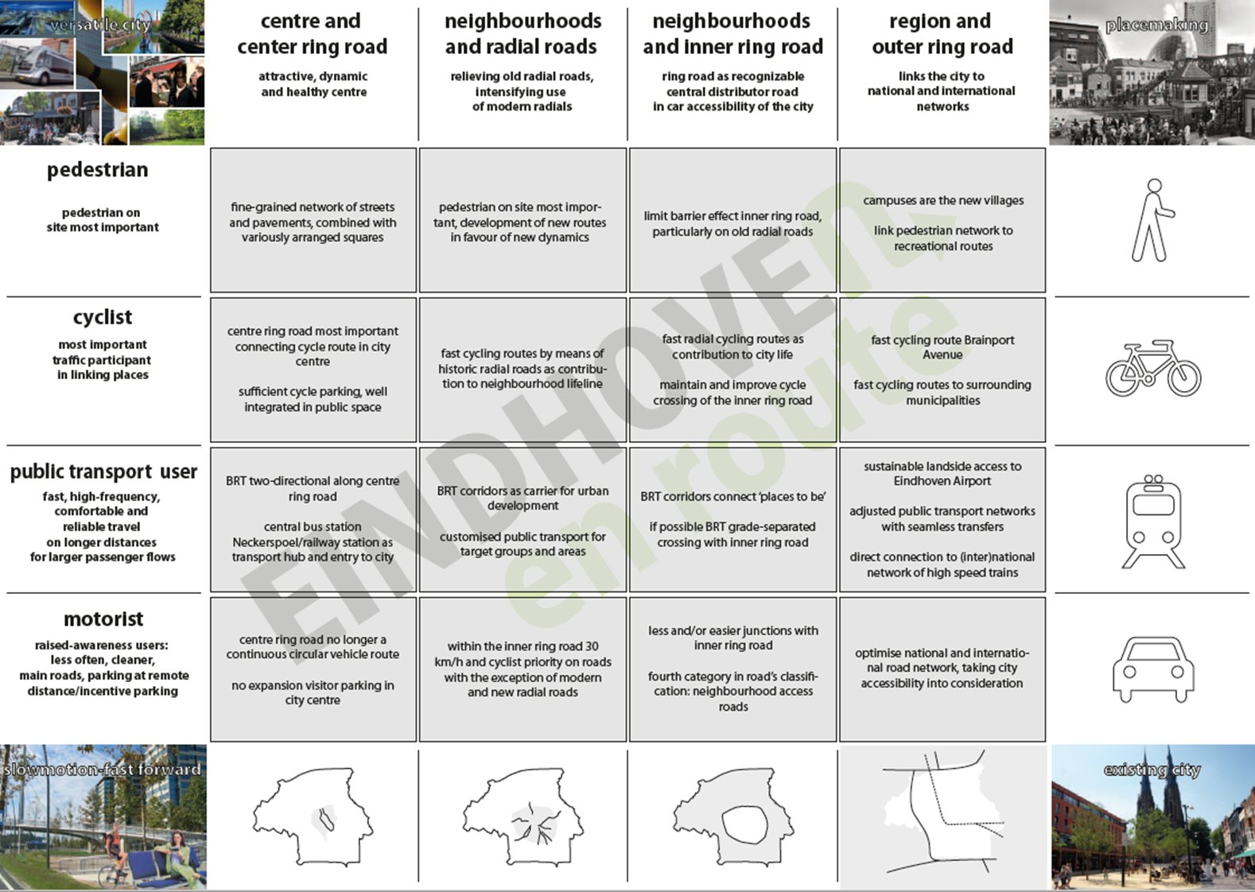

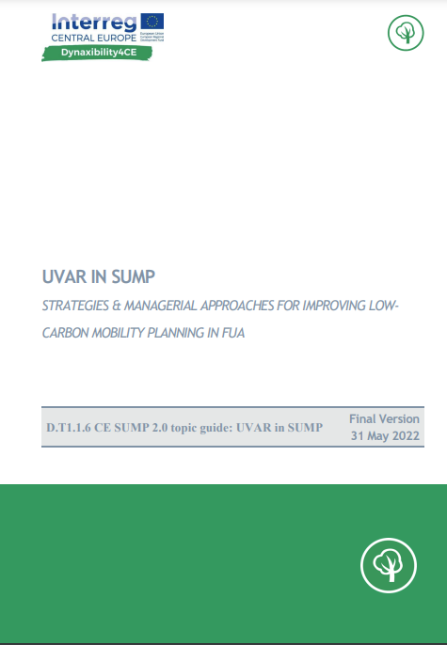

Slide 25
SUMP as framework for UVAR
Spatial Interventions
Pricing measures
Regulatory measures
Complementary measures
Ensuring Compliance
ACCESS to UVAR Information
Access to vehicle/driver information
Notes:
Long list in 3 MF + FO and CM, methodology of combining BB for different strategies

Slide 26

Access to vehicle information and driver data
European Electronic Tolling System
Cross border enforcement directive

Slide 27
So, what does the EU do to support UVARs?
NOT
BUT
Why UVARs are put in place
Whether UVARs are deployed or not?
How UVARs are designed…
Technology pathways to enable and support UVAR deployment and compliance
‘Bigger picture’ legislation: Climate neutrality, digital and green transition
Governance to relate member states to the local level: Expert Group on Urban Mobility

Slide 28
UVARs in the
Expert Group on Urban Mobility
Follow up to projects UVARbox , UVAR Exchange and CIVITAS ReVeAL
Technical , digital and legal/regulatory perspectives at EU, Member States and cities level
Follow up study (mapping exercise) to be launched in 2023
Link to implementation of Regulation (EU) 2018/1724 on the “Single Digital Gateway”
Link to Delegated Regulation on real time traffic information (data to include new data sets, such as those pertaining to UVARs), ITS Directive
UVAR inclusion within an integrated SUMP approach
Inclusion of parking management as element of affecting

Slide 29
SUMP as framework for UVAR
Spatial Interventions
Pricing measures
Regulatory measures
Complementary measures
Compliance
ACCESS to UVAR Information
Access to vehicle/driver information
Notes:
Long list in 3 MF + FO and CM, methodology of combining BB for different strategies

