Slide 1
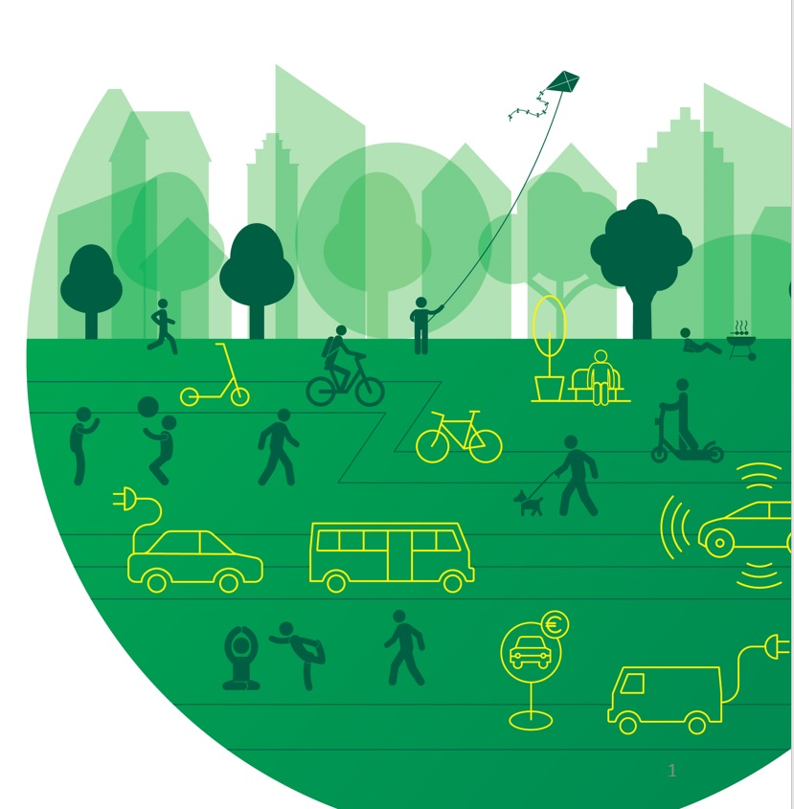
UVARBox & UVAR Exchange
Lucy Sadler
ReVeAL: https://civitas-reveal.eu
Sadler Consultants (Germany)
www.urbanaccessregulations.eu

Slide 2
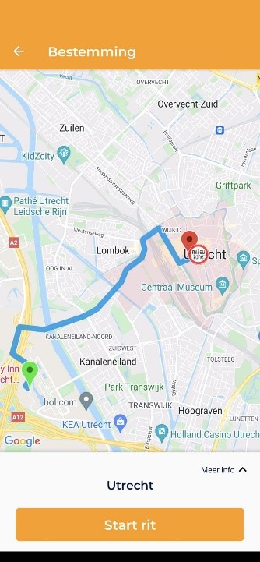
Purpose of UVAR Box = UVAR in M2M format Why?
M2M (Machine to Machine readable)
Let’s face it, 99% of those travelling in an unknown area
Use a digital navigation tool / Sat Nav
…or what the navigation device tells them
The devices need to include UVARs
This needs cities help
Ensuring Compliance: Only comply with that they know

Slide 3
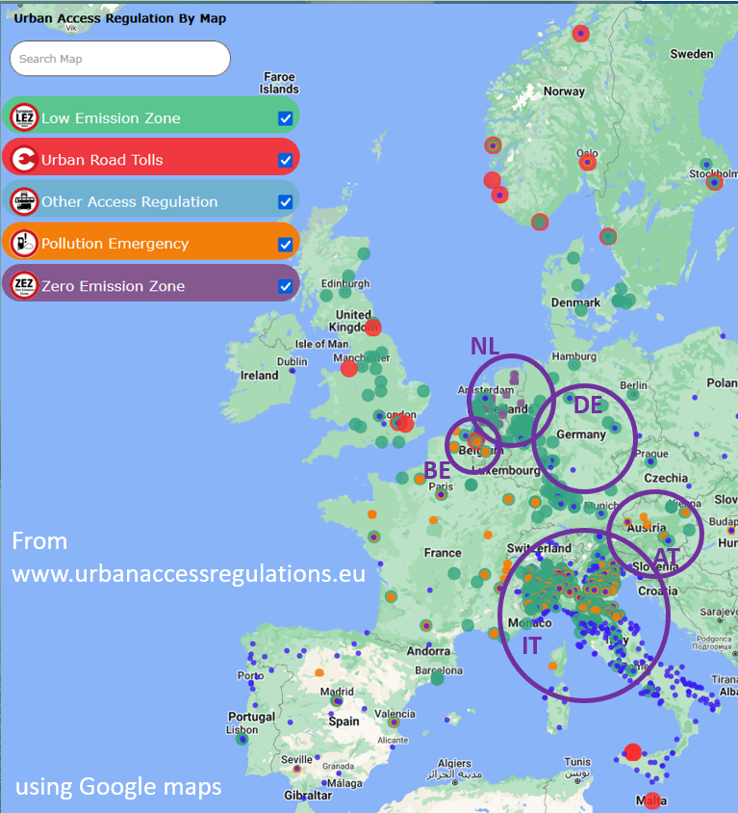
UVAR Box
User-friendly tool to help UVAR authorities to put UVAR regulations into Machine to Machine (M2M) readable data
Create M2M data for
LEZs in 5 Member States
Focus Countries: Austria, Belgium, Germany, Italy, the Netherlands
At least one of each UVAR type
UVAR definition: LEZ, LTZ, Congestion Charges, Parking zones, pedestrian zones, Emergency schemes
How to get cities to digitise UVARs
SUMP Guidance, benefits, EU law, NAPCORE…..
Tool available at: https://uvarbox.eu/uvarbox-tool together with manual & video

Slide 4
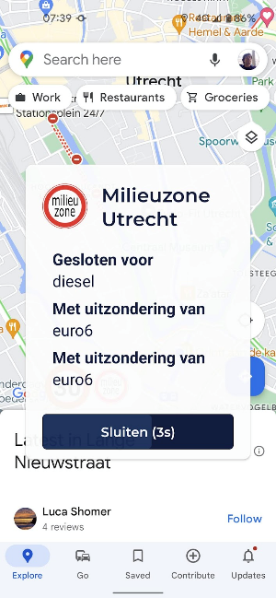
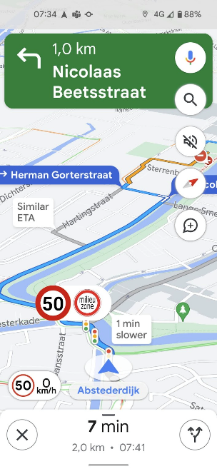
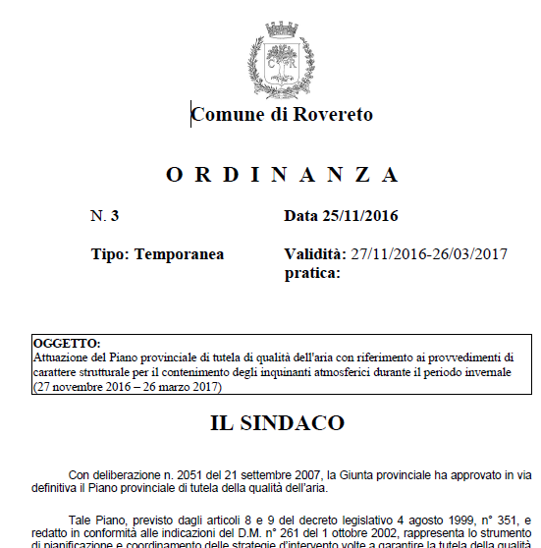
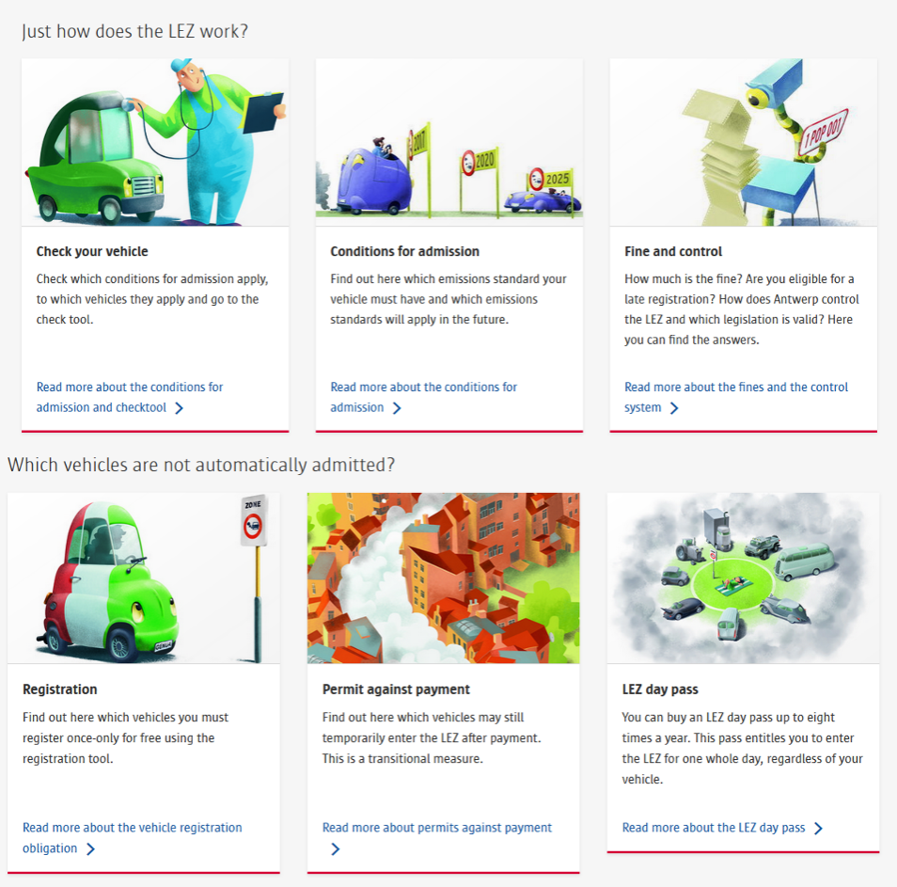
Communication Conversion
Also digital / M2M → Navigation Tools
DATEX II
format
On NAP & city/MS
Open Data
portals
Antwerp city’s LEZ website
& of course many other
Communication forms…
Onderweg App

Slide 5
Why should I digitise my UVAR?
Advantages to cities include:
Greater awareness → greater compliance → greater impact
Greater awareness = less enforcement work = fewer complaints & queries
Service Providers (e.g. Google) increasingly contacting cities for UVAR data If provide to one (in their requested format) = need to provide similarly for others (Open Data Directive)
Using UVAR Box → single EU-wide DATEX II format = provide data once only on National Action Point & city/national open data websites
Information on emissions stickers and national traffic rules required on the Single Digital Gateway by end 2023. UVARs also on the SDG. Needed in SDG format - DATEX II can be easily imported into SDG format.
ITS Directive & delegated regulation requires Member States to digitise UVARs & encourage cities to do so too. Revised regulation likely to require UVARs to be digitised.
UVARs in navigation services significantly reduce the resistance to UVARs at an EU and non-local level
Cities often have own general digitisation processes
Some Countries & Cities working on “digital mirror” of traffic regulations (eg METR)
Digital UVAR data also needed for eg geofencing, ISA, connected & automated vehicle deployment
→ It will make a more effective UVAR !
So use the UVAR Box tool!
More details: UVAR Box tool
UVAR Box final conference recordings

Slide 6
UVAR Exchange
Three aims:
Identify how to achieve EU-wide foreign vehicle enforcement
Options / recommendations to the European Commission
Recommendations on better & clearer UVAR signage
‘horizontal & vertical’ road signs (metal standing or painted on road)
Variable Message Signs (VMS)
Guidance & demonstrations
Incorporated into ReVeAL Guidance Document
Demonstrating cooperative-ITS/geofencing including digital ITS services for car navigation systems.
Demonstrated, however for UVARs mainly for updating navigation tools (and emergency/triggered UVARs)

Slide 7
UVAR Exchange Main signs
Pictograms; text should be minimised
Local abbreviations and acronyms should be avoided
Both on Entry, and early enough to allow diversionary route

Slide 8
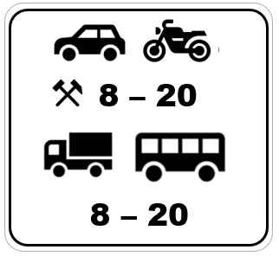
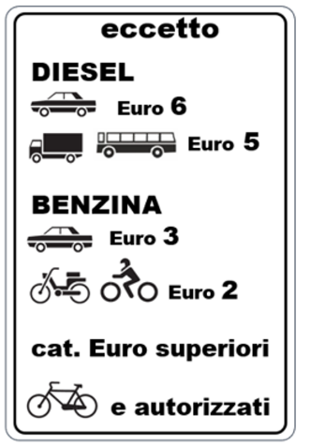
UVAR Exchange Supplementary panels
To give further details on the UVAR
For updates see https://uvarbox.eu/uvar-exchange/

Slide 9
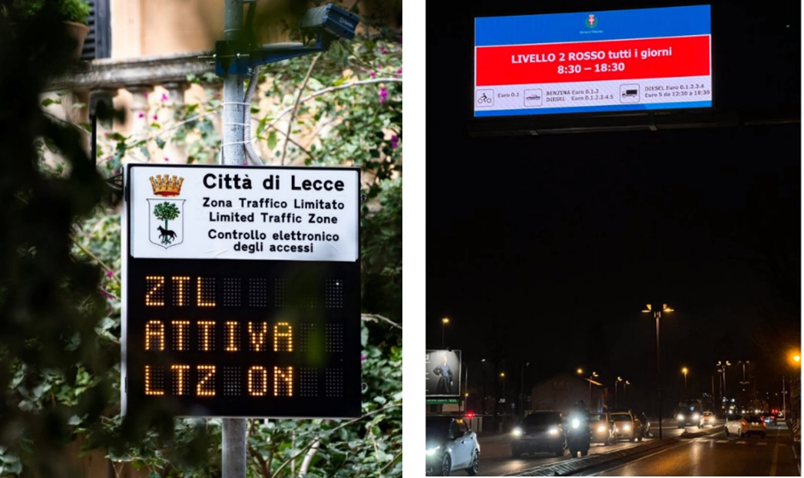
VMS
Pictograms (same as road signs)
Information reliable & up to date
Free text kept to a minimum (5-7 words)
Avoid local abbreviations & acronyms
Bilingual messages when possible (national & English)
VMS turned off when UVAR is not active

Slide 10
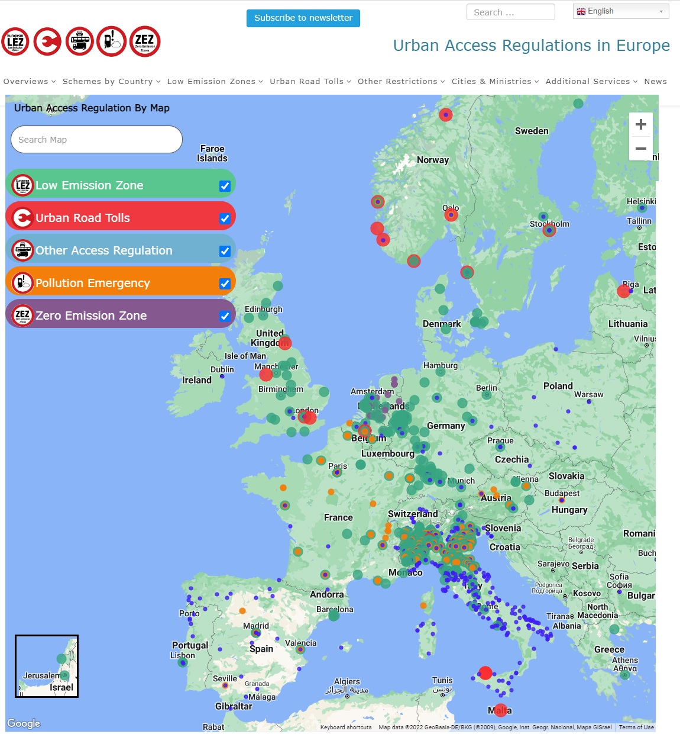
For more information
https://uvarbox.eu
https://uvarbox.eu/uvarbox-tool
https://uvarbox.eu/uvar-exchange
Lucy Sadler lucy.sadler@airqualitypolicy.eu
www.urbanaccessregulations.eu

